Slide 1
Lesson 1 - Intro to Lists/Arrays
Mr Mack 2019

Slide 2
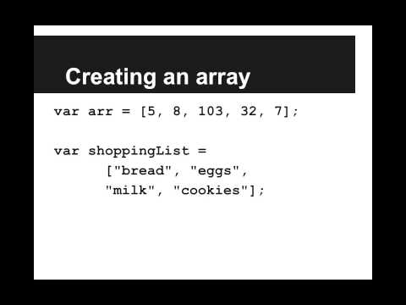
Intro to Lists/Arrays

Slide 3
We want to make a grocery list in our program. Which of the following is the correct way to make an array/list?
var groceries = "milk, sugar, eggs, cake";
var groceries = ["milk, sugar, eggs, cake"];
var groceries = ["milk" "sugar" "eggs" "cake"];
var groceries = ["milk", "sugar", "eggs", "cake"];

Slide 4
What is an array (or list)?
An ordered collection of items
An unordered collection of items
A function
A type of loop

Slide 5
Example: Making an Array
This is an example for this lesson. You are encouraged to play around with it, run and change the code, and learn how it works. When you are done, click continue to go to the next problem.

Slide 6
Exercise 5.1.1: List of Places to Travel
Create an array of the top 5 places you would like to travel called travelList. Print out the item at index 2.

